Slide 1

Alan Smith OBE
Principal Methodologist
ONS (UK) Data Visualisation Centre
flickr.com/dbduo photography
EMERGING
TRENDS
IN DISSEMINATION

Slide 2
The Official Context

Slide 3
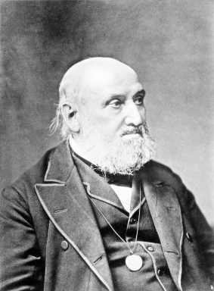
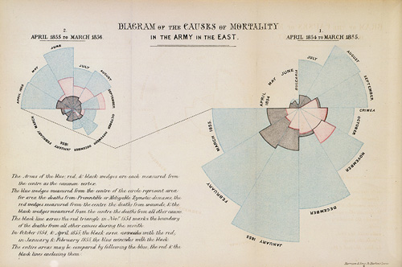
William Farr (1807-1883)
“You complain that your report would be dry [without the graphics]…
…THE DRYER
THE BETTER.
Statistics should be the dryest of all reading”
letter to Florence Nightingale, 1861

Slide 4

“…Among the Code of Practice requirements are that producers of official statistics should prepare full and frank commentary and analysis that aid interpretation including:
information on the quality and reliability of statistics in relation to the range of potential uses
information on methods, procedures and classifications
factual information about the policy or operational context
formats for the presentation of statistics in graphs, tables and maps that enhance clarity, interpretability and consistency…
…In the view of the Statistics Authority, the public has a right to know the statisticians’ understanding of the messages from the statistics, just as they have a right to the data itself. It is common, and proper, for statisticians in government departments to brief policy colleagues on the substance of the statistics. That knowledge should, as a matter of principle, be shared more widely.”
(The Value of Statistical Commentary, 23rd July 2010)

Slide 5
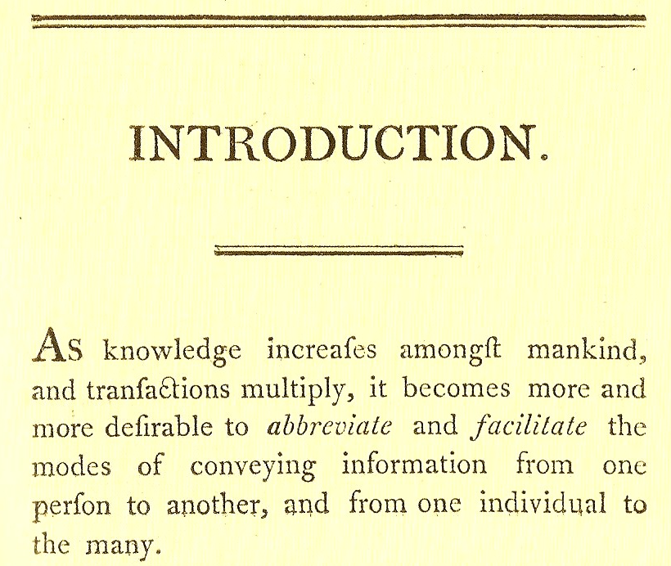
Today’s challenges are not new
William Playfair, The Statistical Atlas, 1801

Slide 6
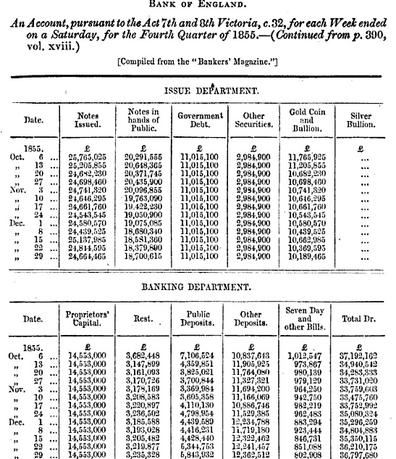
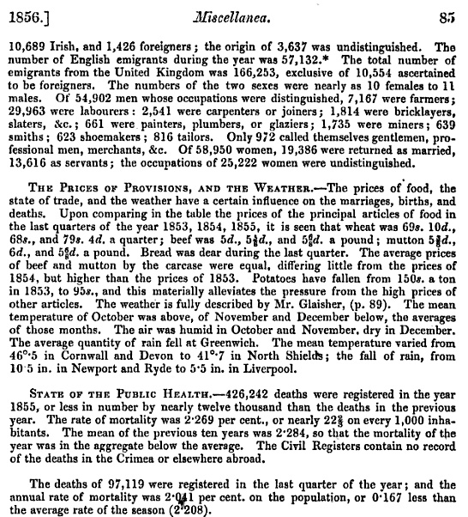
The 1st content revolution…
From the 19th Journal of the Royal Statistical Society, 1856

Slide 7
“…no study is less alluring or more dry and tedious than statistics…
…unless the mind and imagination are set to work”
William Playfair,
The Commercial and Political Atlas (1801)

Slide 8
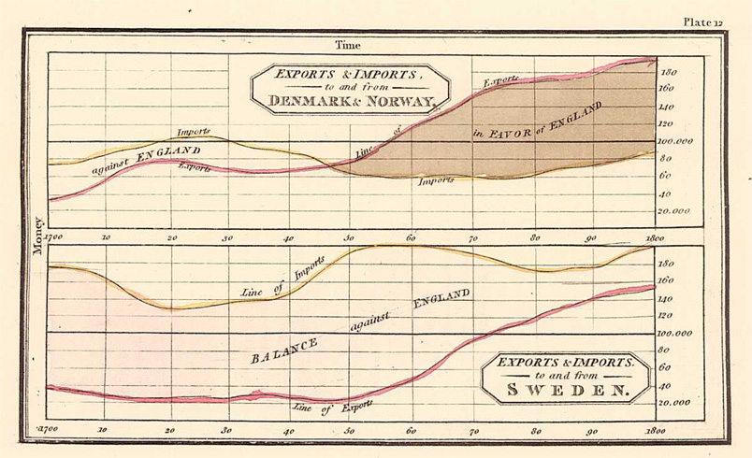
William Playfair, The Commercial and Political Atlas (1801)

Slide 9
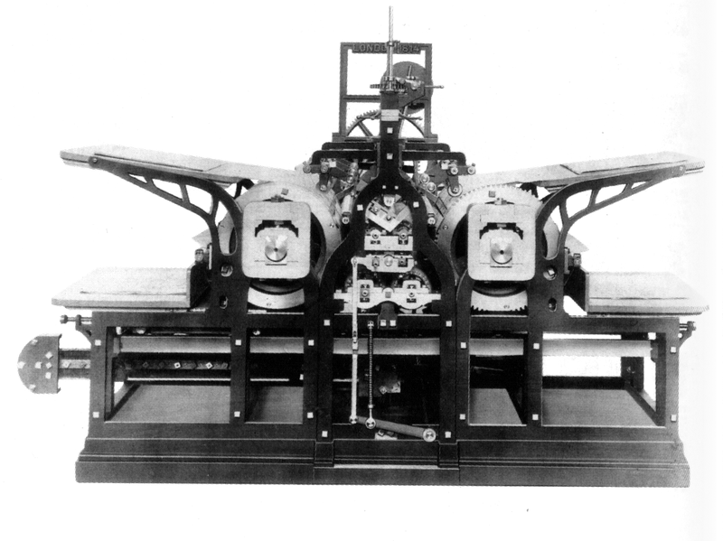
In the late 18th/early 19th Century, innovations in publishing created a revolution in communication that encouraged mass participation, challenges to traditional ideas of government and led to fundamental and permanent changes in the relationship between citizen and state
Koenig’s steam press, 1814
Sound familiar?
PAPER was the HTML of its day
printing presses were the broadband
pamphleteers were bloggers and citizen journalists

Slide 10

Hal Varian
“I keep saying the sexy job in the next ten years will be statisticians…The ability to take data - to be able to understand it, to process it, to extract value from it, to visualize it, to communicate it is going to be a hugely important skill in the next decades…because now we really do have essentially free and ubiquitous data. ”

Slide 11
CONTENT - FROM PRINT TO WEB
ADVANTAGES:
Searchable, linkable, non-linear
Non-static, user interaction
Flexible republishing
DISADVANTAGES:
Not permanent
Formats
Archiving
MAXIMISE
MINIMISE

Slide 12
Thinking about web content

Slide 13
?

Slide 14
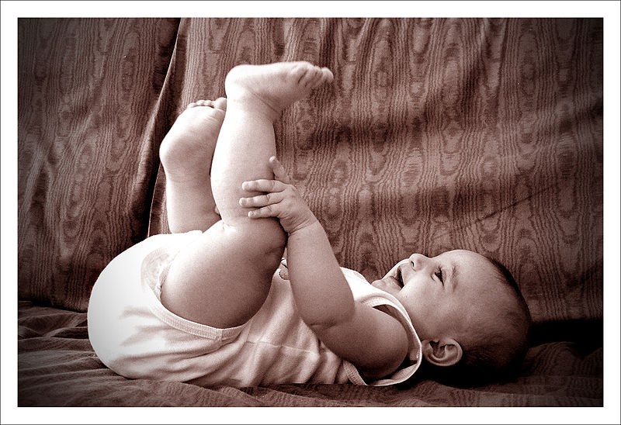
Joshua?
Kevin?
Charlie?
Thomas?
William?
George?
Oliver?
James?
Jack?
Harry?
Alfie?
http://www.flickr.com/photos/8314403@N03/2620922750/ Happiness

Slide 15
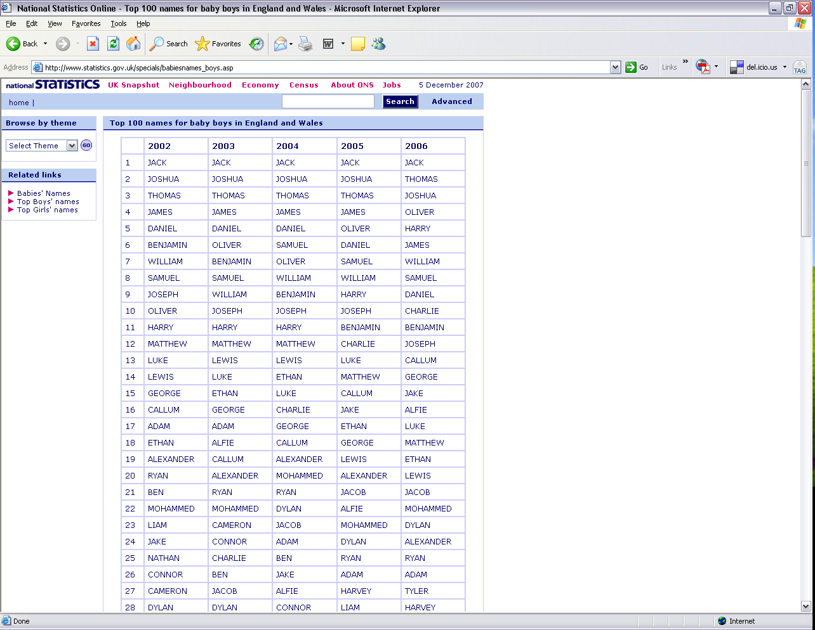

Slide 16
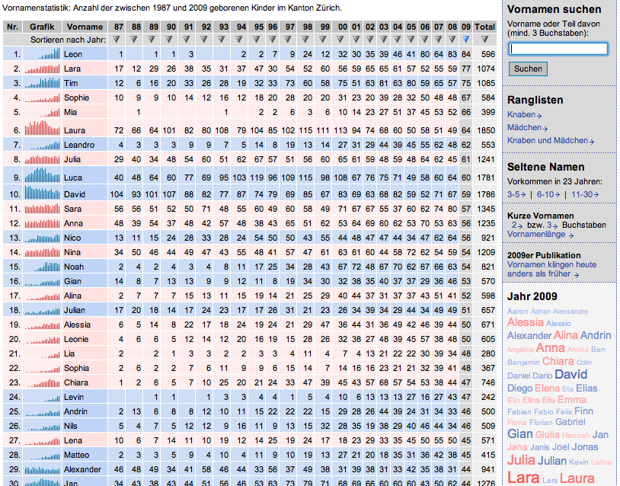

Slide 17
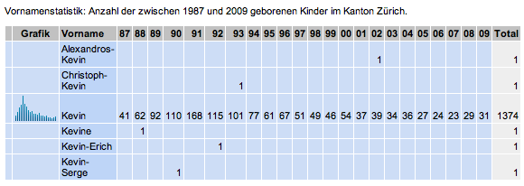



Kevin
X
X
?

Slide 18
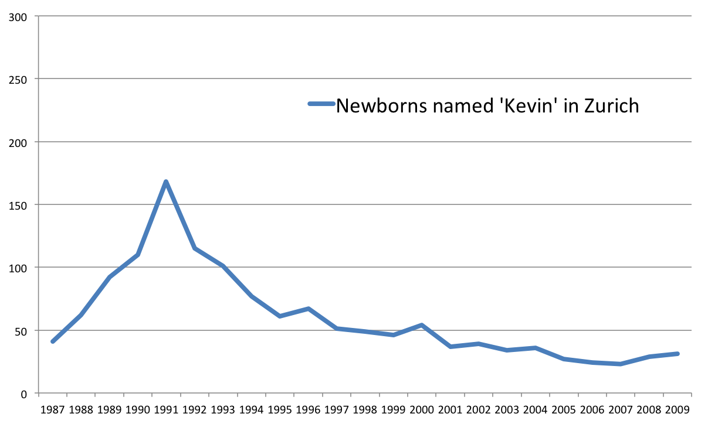
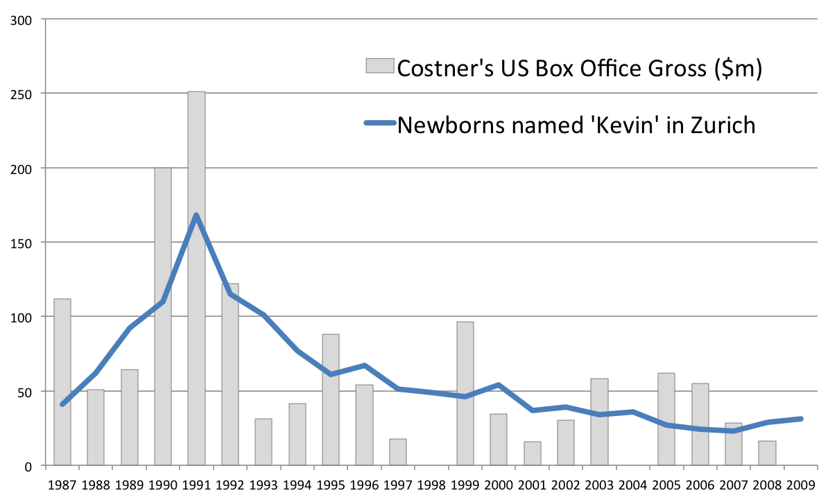

ANALYSIS: Kevin Costner and Babies in Zurich
the untouchables (1987)
dances with wolves (1990)
robin hood, jfk (1991)
the bodyguard (1992)
wyatt earp, the war (1994)
= 0.73
source: Zurich Canton and the-numbers.com

Slide 19
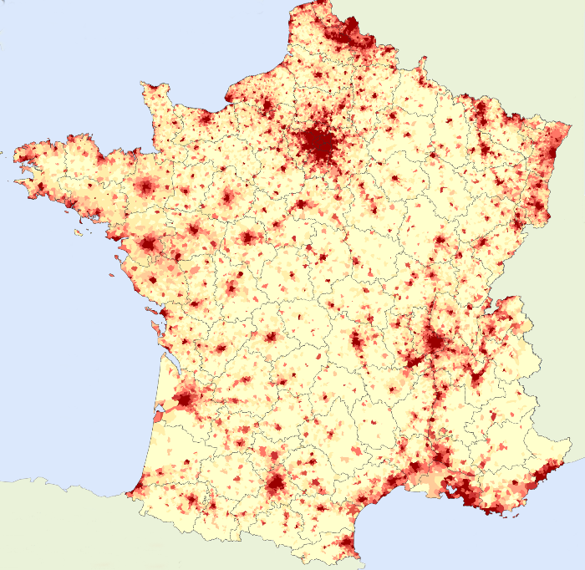

EPILOGUE
“Given that Zurich is predominately German speaking (French is the first language for only 2.1%), one wouldn't expect that parents in Zurich were just being influenced by France. Is this additional evidence of the Costner effect? It is a bit depressing to think that KC could have such an impact.”
Kevin Pickering
Head of Statistics
National Centre for Social Research

Slide 20
Rich content is not just prettier…
…it can be smarter

Slide 21
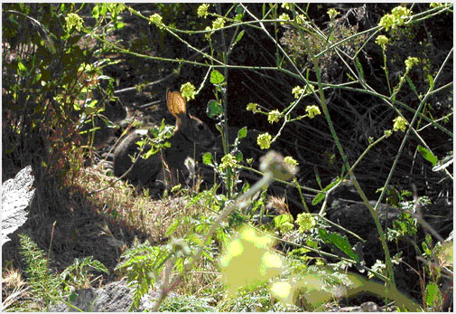
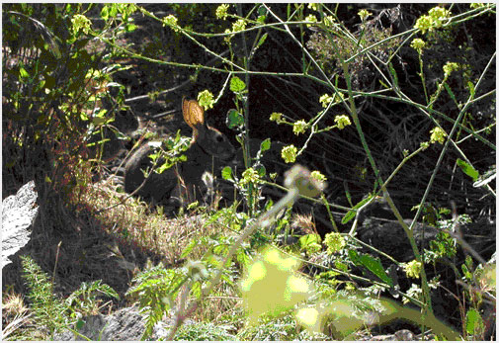
Restrictions of Static Imagery
source: http://www.socsci.uci.edu/~ddhoff/

Slide 22
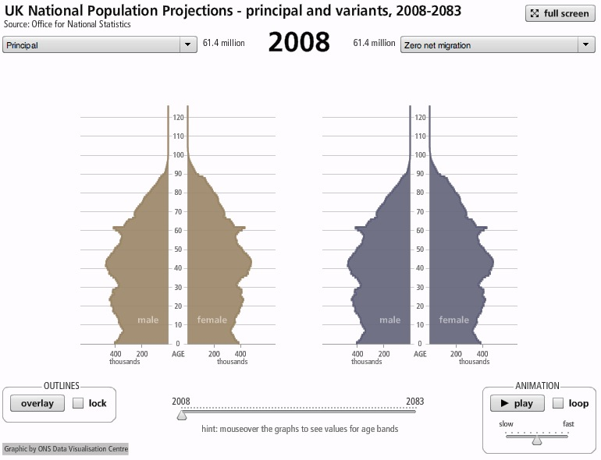
Spot the Difference

Slide 23
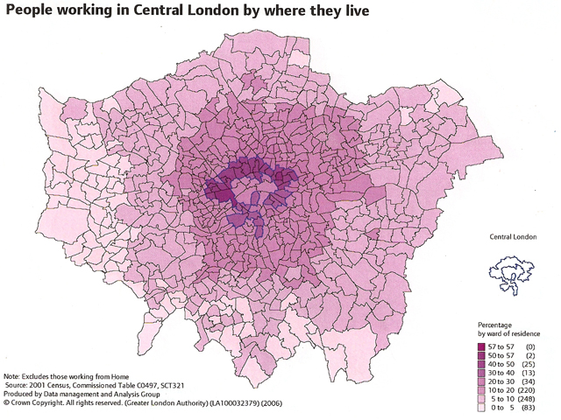
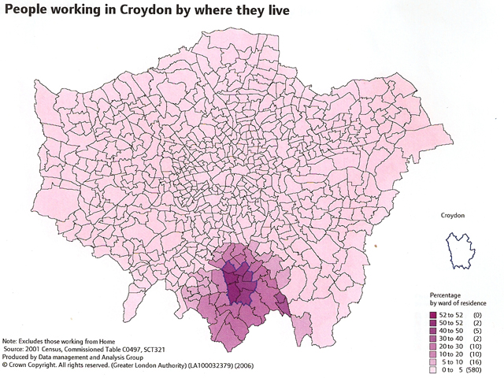
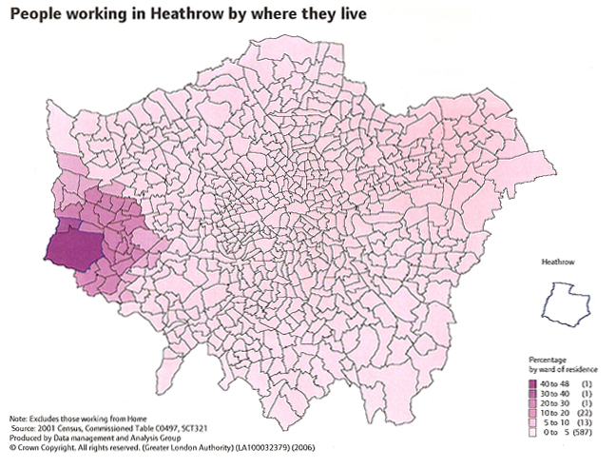
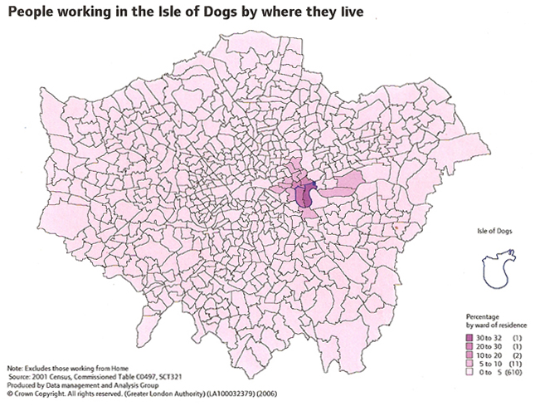

Slide 24
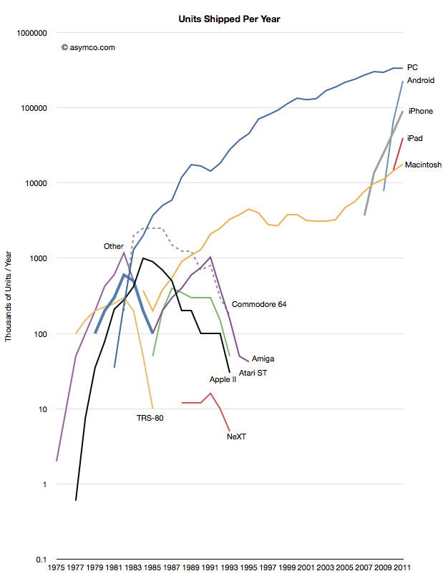
MOBILE PLATFORMS
  Apple has sold over 360 million ‘iOS’ devices (iPad/iPhone/iPod Touch)
  In 2011, 45% of all UK internet users went online via mobile devices (in 2010, it was 31%)
  71% of 16-24 year olds online via mobile devices
  A clear need to support mobile devices–in addition to continuing desktop support

Slide 25
MOBILE CONTENT
2 principal content routes
‘Apps’ – proprietary applications, authored for each type of device:
  Apple app store
  Android marketplace
  Windows, Blackberry etc…
  In the UK, strong guidance for central government NOT to enter this environment…
Web apps – open applications, for the web browser, based on HTML5 technology…

Slide 26
RICH CONTENT – Flash v HTML5
Many great web visualisations have been authored using Adobe Flash – a single software plug-in for “rich content”
But most of the web is now moving to ‘open standards’
And Adobe has discontinued ‘mobile flash’…just as the web is going mobile

Slide 27
HTML5
A loose term for a family of technologies:
HTML ( for text and document structure)
CSS (for document appearance)
SVG (for vector graphics)
Canvas (for bitmap graphics)
Javascript (for interactivity)
XML (for structured data)
Crucially, many javascript libraries (jQuery, modernizr,d3) making development easier

Slide 28

ONS Migration Map project
“HTML5 for statistics”

Slide 29
Supported Platforms
All current versions of major desktop browsers:
Internet Explorer (9+)
Firefox
Google Chrome
Safari
Opera
All current versions of major mobile browsers:
Mobile Safari (iOS5+)
Android Browser (v.3+)
Back in September 2011, when project started, only 45% of ONS visits had supported browser. Six months later (March 2012) nearly 60%
Main problem is IE7/8 – Google Chrome plugin available…

Slide 30

DOESN’T THIS TAKE TOO MUCH TIME?
Well, it should take some time, because it’s important
Don’t shortcut the design process
Instead, look for efficiency in production by taking advantage of emerging technical trends…

Slide 31
THE KEY TREND
“The Internet is evolving into a global, living, networked computer that anyone can program”
Don Tapscott and Anthony D. Williams
Wikinomics

Slide 32
APPLICATION PROGRAMMING INTERFACE (API)
APIs are driving content integration and innovation on the web
Example – http://www.census.gov/developers/
“The [Census] Bureau wants to be a source for mobile data, not an app builder”
Steven Buckner, director Center for New Media & Promotion
an API can drive internal innovation and efficiency…

Slide 33
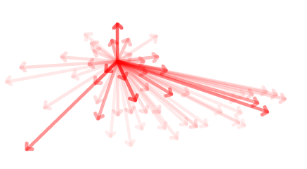
THANK YOU
Questions?
alan.smith@ons.gsi.gov.uk
advice
DATA
VISUALISATION
CENTRE
production
bit.ly/onsdvc
design
@theboysmithy

